Slide 1
Report of Agile2014
As a Speaker and a Reporter
of the latest Agile in the world
Aug/07/2014
Hiroyuki Ito
Development Process Optimization Department, Rakuten, Inc.
http://www.rakuten.co.jp/
Notes:
Hello everyone.
In this session, I’d like to talk about “Technology-Driven Development”.

Slide 2
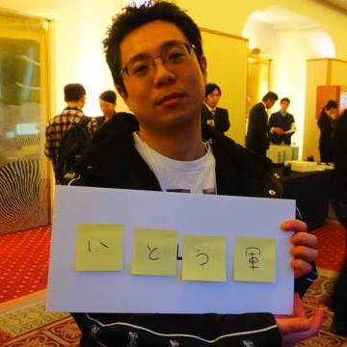
About me
Hiroyuki Ito
(The Hiro)
@hageyahhoo
Test-Driven
Development Group
Notes:
My name is Hiroyuki Ito.
Please call me “The Hiro”.
I’m from Japan.
I belong to “Test-Driven Development Group” in Rakuten.
I have 2 certifications of Scrum.
Now I’m working as an Agile Coach.

Slide 3
What is Agile2014?
Notes:
Again, this session’s theme is “Technology-Driven Development”.
Of course, this name is derived from “Test-Driven Development”.
Anyway, what is “Technology-Driven Development”?

Slide 4
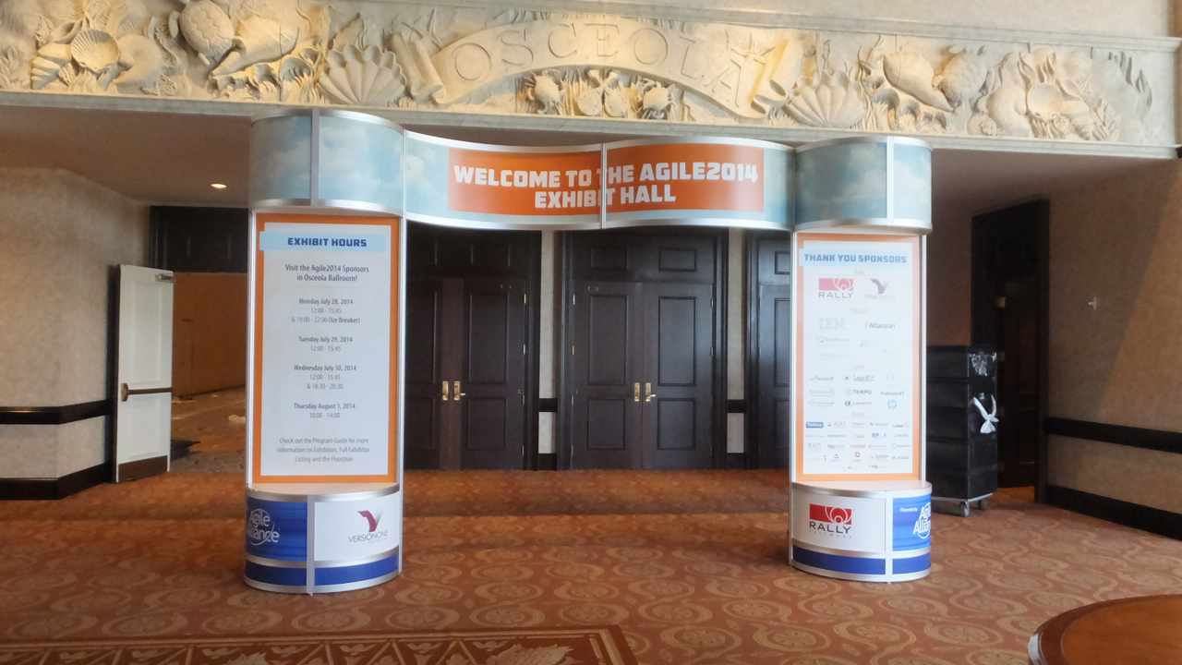



The world’s largest Agile Conference
WALL ATDD
WALL TDD
WALL CI/CD

Slide 5
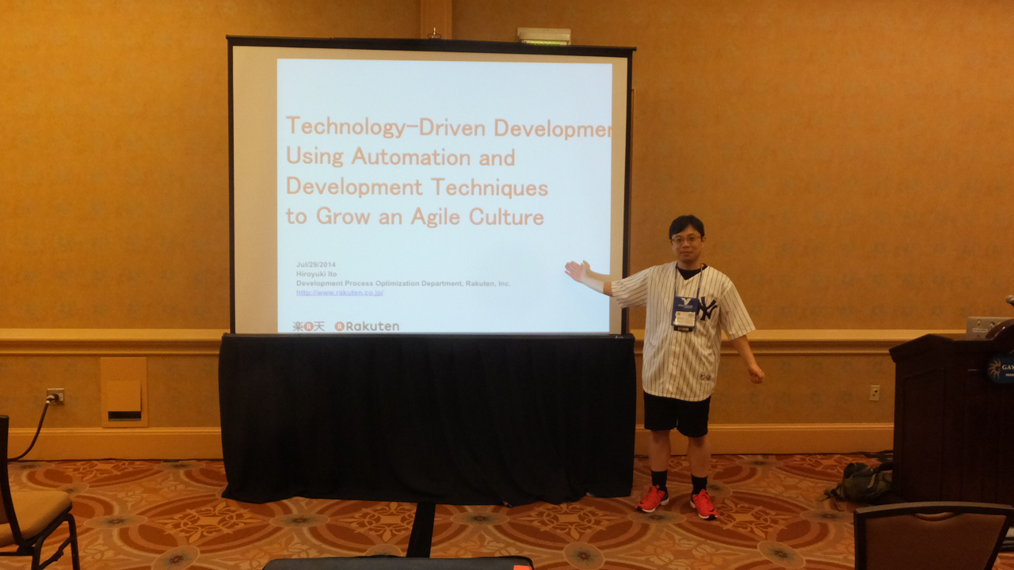
Attended as a session speaker!
Notes:
My name is Hiroyuki Ito.
Please call me “The Hiro”.
I’m from Japan.
I belong to “Test-Driven Development Group” in Rakuten.
I have 2 certifications of Scrum.
Now I’m working as an Agile Coach.

Slide 6
Agenda
1. Basic Information about Agile2014
2. My Presentation
3. The Latest Trend of Agile
4. Conclusions
Notes:
Here is this session’s agenda.
At first, I will talk about the conditions and the challenges of my project.
Next, I will explain the concrete approaches, CI/CD, TDD, and BDD.
After that, I will talk about the results, problems, possibilities, and the future of Technology-Driven Development.
At last I will conclude this report.

Slide 7
1. Basic Information about Agile2014
2. My Presentation
3. The Latest Trend of Agile
4. Conclusions
Notes:
Here is this session’s agenda.
At first, I will talk about the conditions and the challenges of my project.
Next, I will explain the concrete approaches, CI/CD, TDD, and BDD.
After that, I will talk about the results, problems, possibilities, and the future of Technology-Driven Development.
At last I will conclude this report.

Slide 8
Basic information
Location | Orlando, Florida, U.S.
Duration | 4.5 days
Attendees | Approximately 2000 persons
Sessions | 272 persons
Session Speakers | Over 280 persons
Notes:
Therefore, I was highly-motivated!

Slide 9
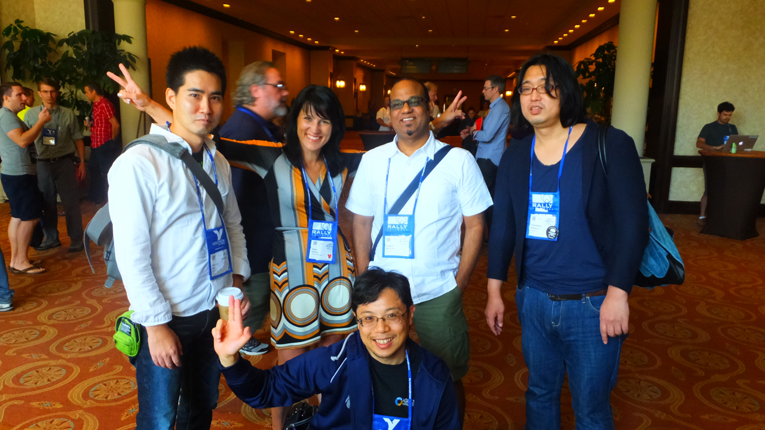
Rakuten all superstars!
Yasnob (TDD)
Dana (R Marketing)
Abex (BDD)
Pramod (PJM)
TheHiro (TDD)
Notes:
It means the new possibilities of Automation.

Slide 10
Trend of sessions
Category | 2014 | 備考
Adoption & Transformation | 0
Agile Bootcamp | 7
Coaching & Mentoring | 16
Collaboration Culture & Teams | 23
Crouedsourced | 0 | 2013年のみ設けられた
Development Practices & Craftsmanship | 28
Distrubuted Agile | 0
DevOps | 15
Emerging Applications of Agile | 0
Enterprise Agile | 28
Insight - Experience Reports(2012) / Experience Reports(2013-) | 25
Keynote | 3
Leadership | 16
Lean Startup | 0 | 2013年のみ設けられ，本カテゴリのセッションは他のカテゴリをまたがったものばかりとなった
Learning | 15
Lightning Talks | 3 | 2012年は単独でもResearch含むセッション内にもLTは存在しない 2013年は複数のカテゴリにまたがっていたものが，2014年は独立カテゴリになった． 2013年のセッション数はLTを含む場合，総数から-1している(Researchは除く)
Weekly Event(2012) / Open Jam(2013-) | 4 | 2012年はCoaches Clinicなど含む。4日実施する、という意味
Project Program and Portfolio Management | 24
Research | 9 | Research LTがReseachカテゴリ独自に存在する(2013年，2014年ともに)
Daily Envent(2012) / Special Events(2013-) | 9 | パーティ等が該当。外しても良いかも。
No Bull Know How(2012) / Stalwarts(2013-) | 8
Testing & Quality Assurance | 13
User Experience | 11
Business Value and Working With Stakeholders(2012) / Working with Customers(2013-) | 15
合計 | 272

Slide 11
Comparison of trends
 | session数
Category | 2012 | 2013 | 2014 | 備考
Adoption & Transformation | 26 | 0 | 0
Agile Bootcamp | 7 | 7 | 7
Coaching & Mentoring | 15 | 15 | 16
Collaboration Culture & Teams | 18 | 15 | 23
Crouedsourced | 0 | 14 | 0 | 2013年のみ設けられた
Development Practices & Craftsmanship | 16 | 20 | 28
Distrubuted Agile | 5 | 0 | 0
DevOps | 0 | 13 | 15
Emerging Applications of Agile | 5 | 0 | 0
Enterprise Agile | 21 | 19 | 28
Insight - Experience Reports(2012) / Experience Reports(2013-) | 20 | 14 | 25
Keynote | 3 | 3 | 3
Leadership | 13 | 12 | 16
Lean Startup | 0 | 15 | 0 | 2013年のみ設けられ，本カテゴリのセッションは他のカテゴリをまたがったものばかりとなった
Learning | 0 | 17 | 15
Lightning Talks | 0 | 0 | 3 | 2012年は単独でもResearch含むセッション内にもLTは存在しない 2013年は複数のカテゴリにまたがっていたものが，2014年は独立カテゴリになった． 2013年のセッション数はLTを含む場合，総数から-1している(Researchは除く)
Weekly Event(2012) / Open Jam(2013-) | 26 | 4 | 4 | 2012年はCoaches Clinicなど含む。4日実施する、という意味
Project Program and Portfolio Management | 0 | 25 | 24
Research | 8 | 9 | 9 | Research LTがReseachカテゴリ独自に存在する(2013年，2014年ともに)
Daily Envent(2012) / Special Events(2013-) | 9 | 8 | 9 | パーティ等が該当。外しても良いかも。
No Bull Know How(2012) / Stalwarts(2013-) | 9 | 7 | 8
Testing & Quality Assurance | 12 | 11 | 13
User Experience | 12 | 14 | 11
Business Value and Working With Stakeholders(2012) / Working with Customers(2013-) | 17 | 17 | 15
合計 | 242 | 259 | 272

Slide 12
1. Basic Information about Agile2014
2. My Presentation
3. The Latest Trend of Agile
4. Conclusions
Notes:
Here is this session’s agenda.
At first, I will talk about the conditions and the challenges of my project.
Next, I will explain the concrete approaches, CI/CD, TDD, and BDD.
After that, I will talk about the results, problems, possibilities, and the future of Technology-Driven Development.
At last I will conclude this report.

Slide 13
This year’s session speaker!
Notes:
My name is Hiroyuki Ito.
Please call me “The Hiro”.
I’m from Japan.
I belong to “Test-Driven Development Group” in Rakuten.
I have 2 certifications of Scrum.
Now I’m working as an Agile Coach.

Slide 14
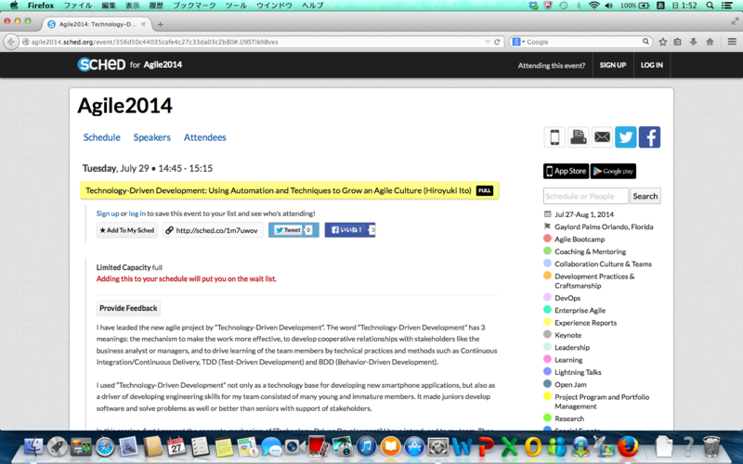
This year’s session speaker!
Notes:
My name is Hiroyuki Ito.
Please call me “The Hiro”.
I’m from Japan.
I belong to “Test-Driven Development Group” in Rakuten.
I have 2 certifications of Scrum.
Now I’m working as an Agile Coach.

Slide 15
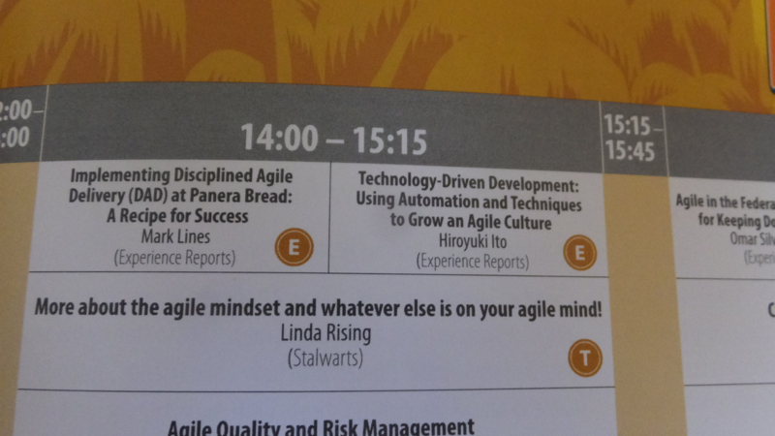
This year’s session speaker!
Notes:
My name is Hiroyuki Ito.
Please call me “The Hiro”.
I’m from Japan.
I belong to “Test-Driven Development Group” in Rakuten.
I have 2 certifications of Scrum.
Now I’m working as an Agile Coach.

Slide 16
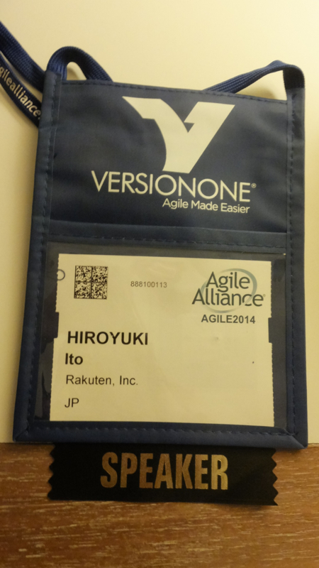
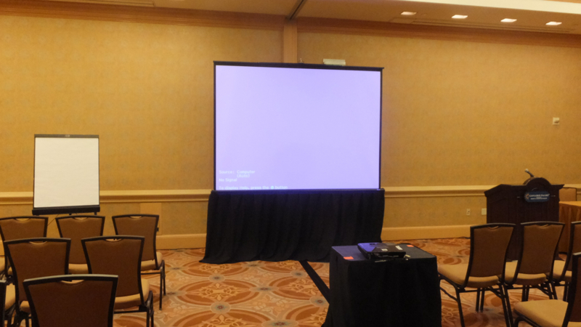
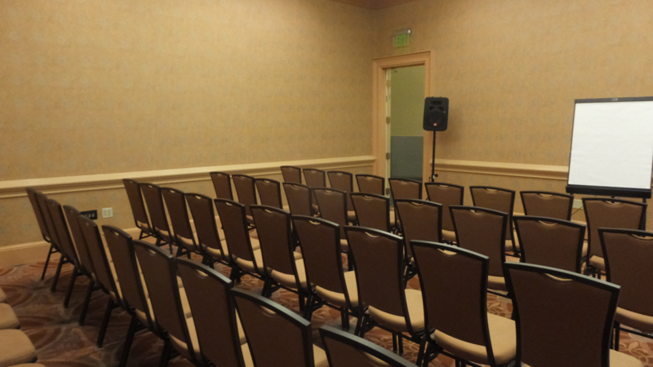
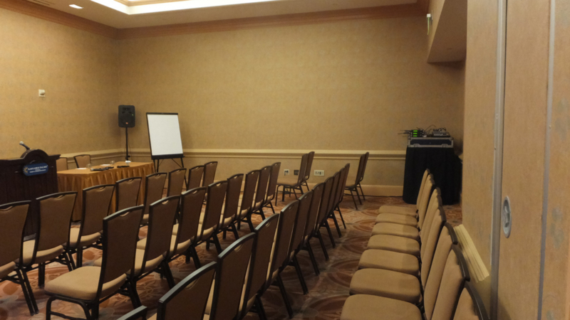
This year’s session speaker!
Notes:
My name is Hiroyuki Ito.
Please call me “The Hiro”.
I’m from Japan.
I belong to “Test-Driven Development Group” in Rakuten.
I have 2 certifications of Scrum.
Now I’m working as an Agile Coach.

Slide 17
This year’s session speaker!
Notes:
My name is Hiroyuki Ito.
Please call me “The Hiro”.
I’m from Japan.
I belong to “Test-Driven Development Group” in Rakuten.
I have 2 certifications of Scrum.
Now I’m working as an Agile Coach.

Slide 18
http://d.hatena.ne.jp/hageyahhoo/20140730/1406683408
Notes:
About Rakuten.
Rakuten is an e-commerce company from Japan.
We provide so many services like this.

Slide 19
Result
実際の参加者は６０名程度。日本人聴講者は、把握できた範囲で２名。後は説明しなくても分かりますね？
プロジェクタの設定がいじられていて、プレゼン資料が画面に収まりきらない問題に遭遇。イベントの都合で待ち時間がほとんどなく、また係の人の協力でも解決することができなかったため、やむを得ず PowerPoint のオリジナル資料をアニメーションなしで説明することにしました。
機材トラブルということで、後で係の方から謝罪を受けました。
発表途中での入退室が自由なのですが、発表途中で抜けた人は３名だけ。ほとんどの人が最後まで聞いてくれました。
質問者は１名。
Q) （BDD まで）どのくらいで実現したの？
A) ３ヶ月くらいですよ～？
Q) ウチをサポートして！w
論文の Shepherding をして下さった Jutta Eckstein さんと Rebecca Wirfs-Brock さんも、発表中ウンウンうなづきながらじっくり聞いて下さいました。そのリアクションのおかげで、安心して発表できました。
発表終了後、「彼はリアルサムライだったね」とおっしゃっているのを耳にしたのですが、一体どういう意味だったのだろう？w
Notes:
Therefore, I was highly-motivated!

Slide 20
Result
英語を公用語化している会社で働いているので、英語で話すこと及び日本人ではない方の前で話すことについては、ほとんど違和感を感じませんでした。これは会社のこれまでの施策の成果と言っても良いのかなと改めて感じました。
社内で３回事前に発表してフィードバックを得てきたので、話すポイントと改善するポイントを事前に把握できたことは大きかったです。公式プレゼンは、面倒でも事前に人前でやってフィードバックを得た方が絶対にうまくなります。
今回の論文の内容だと、３０分で発表するには正直短すぎると感じました。半年以上やってきたことを３０分でポイントを絞って話すことの難しさ・もったいなさ・そして面白さを感じた次第です。
自分が業務を通して考え抜いたことを論文として整理することは、自分の考えを客観性を持った形で整理・評価・説明できるようになる手法を身につけるという意味で、非常に学ぶことが多いです。また、英語で書くことで全世界に自分の考えを届けられる機会を得られます。そのため、英語での論文作成は積極的にされることをオススメします。
Notes:
Therefore, I was highly-motivated!

Slide 21
Result
今回の発表を通じて多くのことを学べたので、同様の学習経験を後輩にさせたいなと考えています。私自身もこれから滾り続けますが、後輩を滾る人間に育成していくことも、人類の成長の営みとしてやっていこうと思います。
Notes:
Therefore, I was highly-motivated!

Slide 22
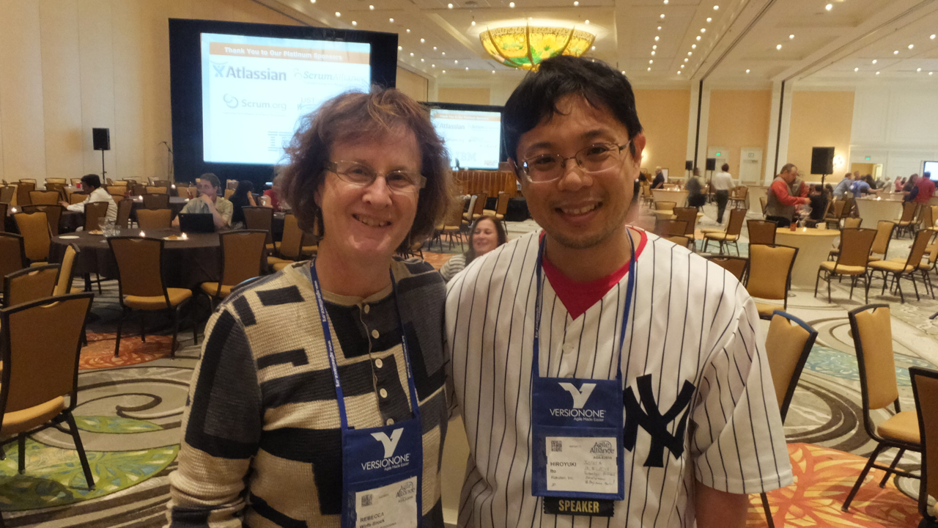
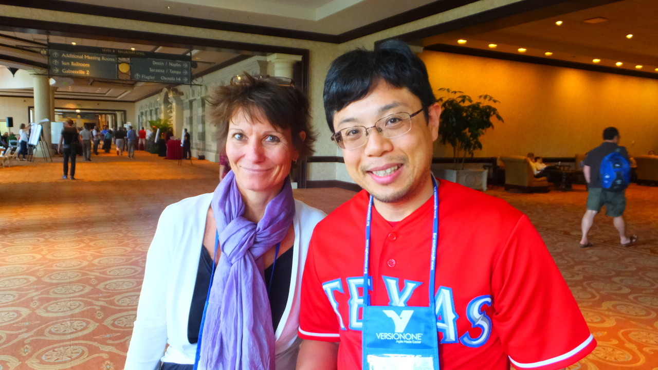
This year’s session speaker!
Notes:
My name is Hiroyuki Ito.
Please call me “The Hiro”.
I’m from Japan.
I belong to “Test-Driven Development Group” in Rakuten.
I have 2 certifications of Scrum.
Now I’m working as an Agile Coach.

Slide 23
1. Basic Information about Agile2014
2. My Presentation
3. The Latest Trend of Agile
4. Conclusions
Notes:
Here is this session’s agenda.
At first, I will talk about the conditions and the challenges of my project.
Next, I will explain the concrete approaches, CI/CD, TDD, and BDD.
After that, I will talk about the results, problems, possibilities, and the future of Technology-Driven Development.
At last I will conclude this report.

Slide 24
Previous Agile
Value
Agile/Scrum/Lean
Notes:
Again, this session’s theme is “Technology-Driven Development”.
Of course, this name is derived from “Test-Driven Development”.
Anyway, what is “Technology-Driven Development”?

Slide 25
The latest Agile
Testing
BDD/ATDD/ET/MT
Metrics
CFD/Kanban/KPIs
Value
Enterprise Agile
Organizational Change/Psychology
Agile/Scrum/Lean
Notes:
Again, this session’s theme is “Technology-Driven Development”.
Of course, this name is derived from “Test-Driven Development”.
Anyway, what is “Technology-Driven Development”?

Slide 26
1. Enterprise Agile
Testing
BDD/ATDD/ET/MT
Metrics
CFD/Kanban/KPIs
Value
Enterprise Agile
Organizational Change/Psychology
Agile/Scrum/Lean
Notes:
Again, this session’s theme is “Technology-Driven Development”.
Of course, this name is derived from “Test-Driven Development”.
Anyway, what is “Technology-Driven Development”?

Slide 27
Enterprise Agile
Developers
Executive
Business
Analyst
Agile Coach
(The Hiro)
UI/UX
Designers
Manager
Over barriers/silos

Slide 28
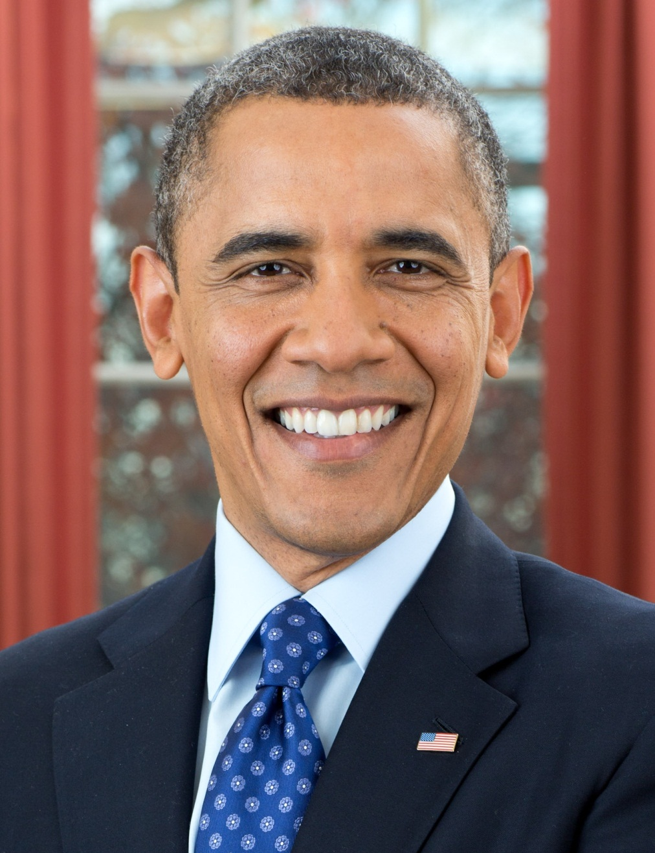
Asked for one executive
YES, YOU CAN!
We changed scope!

Slide 29
This session’s theme
Need
Technical
Foundation
Notes:
Again, this session’s theme is “Technology-Driven Development”.
Of course, this name is derived from “Test-Driven Development”.
Anyway, what is “Technology-Driven Development”?

Slide 30



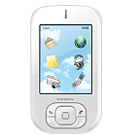
The Implementation of CI/CD in our project
Check-in build (hourly)
My PC
Deliver to
all team members
automatically
Build applications
and run regression tests automatically
We demonstrate latest application
to the business analyst and managers
in every daily scrum

Slide 31
Shared understanding by the working software
Developers
Business
Analyst
Know about
the progress
Get fast feedback
UI/UX
Designers

Slide 32
2. Testing
Testing
BDD/ATDD/ET/MT
Metrics
CFD/Kanban/KPIs
Value
Enterprise Agile
Organizational Change/Psychology
Agile/Scrum/Lean
Notes:
Again, this session’s theme is “Technology-Driven Development”.
Of course, this name is derived from “Test-Driven Development”.
Anyway, what is “Technology-Driven Development”?

Slide 33
Example of BDD test scenario with Calabash-Android
Feature : name of all cases
Scenario : name of each case
Feature: Input
Scenario: Input today’s data
Given I kick drumroll
And drumroll show today
When press next
Then I should see ”xxx" screen
When I press keys and calculator should show like this:
| 2 | 2 |
| 0 | 20 |
| 0 | 200 |
| * | 200 |
| 3 | 3 |
| = | 600 |
Then take photo
…
These statements are
RUNNABLE!
We can write data
with table style like this
Notes:
Here is the example of BDD test scenarios.

Slide 34
Process of BDD
Developers
Business
Analyst
We want to…
We want to…
UI/UX
Designers

Slide 35
Process of BDD
GIVEN …
WHEN …
THEN …
Developers
Business
Analyst
Is that right?
MORE!
MORE! MORE!
We want to…
UI/UX
Designers

Slide 36
Process of BDD
GIVEN …
WHEN …
THEN …
Developers
Business
Analyst
Is that right?
MORE!
MORE! MORE!
OK, go ahead!
UI/UX
Designers

Slide 37
Process of BDD
GIVEN …
WHEN …
THEN …
Developers
Business
Analyst
Is it OK?
UI/UX
Designers

Slide 38
Process of BDD
GIVEN …
WHEN …
THEN …
Developers
Business
Analyst
Is it OK?
MORE!
MORE! MORE!
Sure!
UI/UX
Designers

Slide 39
3. Metrics
Testing
BDD/ATDD/ET/MT
Metrics
CFD/Kanban/KPIs
Value
Enterprise Agile
Organizational Change/Psychology
Agile/Scrum/Lean
Notes:
Again, this session’s theme is “Technology-Driven Development”.
Of course, this name is derived from “Test-Driven Development”.
Anyway, what is “Technology-Driven Development”?

Slide 40
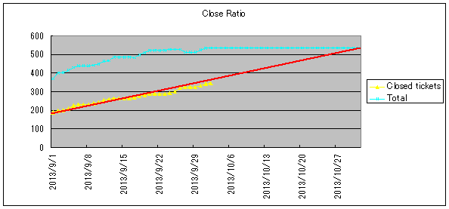
Metrics
[e.g.]
Change requests : 3 times/week
Regression testing : 3 minutes/change
Install applications : 2 minutes/change

Slide 41
KPIs
経営学＆科学的手法で実施している、
改善の仕組み化としての指標は出すべし

Slide 42

http://books.rakuten.co.jp/rk/91a2285c6f0b4fea867632bcd286bf1d/

Slide 43
1. Basic Information about Agile2014
2. My Presentation
3. The Latest Trend of Agile
4. Conclusions
Notes:
Here is this session’s agenda.
At first, I will talk about the conditions and the challenges of my project.
Next, I will explain the concrete approaches, CI/CD, TDD, and BDD.
After that, I will talk about the results, problems, possibilities, and the future of Technology-Driven Development.
At last I will conclude this report.

Slide 44
The world’s largest conference of Agile
XP Europe というものにも、
Agile2014 と同様
Paper & Shepherding process が
あるとのこと
by Jutta Eckstein

Slide 45

http://agile2015.agilealliance.org/

